Slide 1
Lecture 20
Internetworking Models (OSI model)

Slide 2
Internetworking Models
Communication was not open in the earlier days.
ISO developed the Open System Interconnection (OSI) model in late 1970s.
This model uses the Layered Approach for communication between different computer hardware.
This approach divides the network communication process into smaller and simpler components.
This also aids in component development, design and troubleshooting

Slide 3
The OSI Reference Model
The OSI model assists in data transmission between different hosts.
It is also a set of guidelines that application developers can use to create and implement applications that run on a network.
The OSI model is divided into two groups and seven different layers.
Internetworking between devices of different vendors is possible because of this reference model.

Slide 4
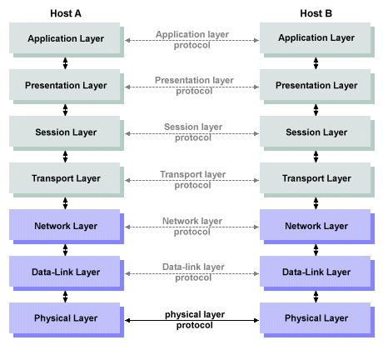
The OSI Reference Model

Slide 5
The OSI Reference Model
The upper layers are the Application layer, Presentation layer and Session layer.
The lower layers are the Transport layer, Network layer, the Data Link layer and the physical layer.
Network hosts operate in all seven layers of the OSI model.
Web and application servers also operates in all seven layers of the OSI model.

Slide 6
The Application Layer
This is the seventh layer of the OSI model.
User actually communicates with a host.
Provides a user interface.
Determines whether sufficient resources for intended communication exists or not.
Application layer protocols are FTP, HTTP, SMTP, POP, SNMP, etc.

Slide 7
The Presentation Layer
This is the sixth layer of the OSI Model.
This layer presents data to the application layer and is responsible for data translation and code formatting.
This layer ensures that the data transferred from the Application layer of one system can be read by the Application layer of the another system.
Data Compression and decompression, also encryption and decryption are associated with this layer.
Primary functions:
Data formatting
Encryption Decryption
Compression and Decompression

Slide 8
The Session Layer
This is the fifth layer of the OSI model.
Helps to keep different applications’ data separate.
This layer create, maintain and terminate sessions.

Slide 9
The Transport Layer
This is the fourth layer of the OSI model.
Provides reliable or unreliable delivery of data.
The transport layer segments data at the sending stream and then reassembles that data at the receiving stream.
They establish logical connection between the sending hosts and the destination hosts.
Transport layer can be either connection-oriented or connection-less.
Connection-oriented communication sessions are established by using the Three-Way-Handshake.

Slide 10
The Transport Layer
The functions of Transport Layer are:
Segmetation and Reassembly
Reliability (Acknowledgment and arrangement according to sequence number in TCP)
Flow Control
Error Checking
Port Addressing
The two protocols used in Transport layer are:
TCP
UDP

Slide 11
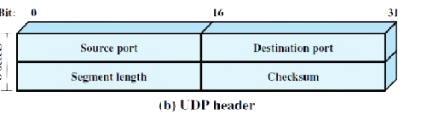
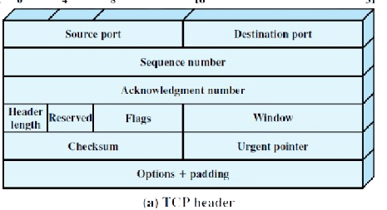
Difference between TCP and UDP
TCP | UDP
It is connection-oriented. | It is connectionless
It arranges packets according to sequence number | It does not arrange.
It is reliable. | It is not reliable.
It uses acknowledgement. | It does not use acknowledgment.
It is slow than UDP. | It is faster than TCP.
Error checking and recovery. | Error checking but no recovery.
It uses Three-Way Handshake | It does not use Three-Way Handshake.

Slide 12
The Network Layer
This is the third layer of the OSI model.
Provides logical addressing (IP address) which routers used for path detection.
This layer also determines the best way to move the data.
Routers and Layer 3 switch work on this layer of the OSI model.
There are two types of packets which are used in the Network layer, Data packets and Route update packets.
The data is encapsulated with Layer 3 header and becomes packet in this Layer.

Slide 13
The Data Link Layer
This is the second layer of the OSI model.
Layer 2 header is added and packets is converted into frames.
Provides access to media using MAC addresses.
This layer ensures that messages are delivered to the proper device on a same network (same subnet) using hardware addresses (MAC).
Data Link Layer is responsible for uniquely identifying devices on a network.
Switches and bridges work on this layer of the OSI model.

Slide 14
The Physical Layer
This is the first layer of the OSI model.
Moves bits of information between devices.
Specifies wire speed and pin outs.
It sends and receives bits, 0s and 1s.
Transmission mediums (Wireless and Wired) fall under this layer of the OSI model.
Hubs also work at the physical layer of the OSI model.

Slide 15
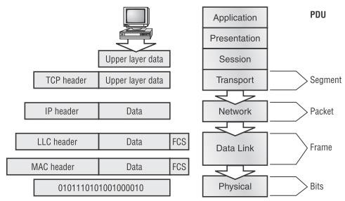
Data Encapsulation

Slide 16
Data Encapsulation
At a transmitting device, the data encapsulation method works like this:
User information is converted into data for transmission on the network.
Data is converted into segments and reliable connection is set up between transmitting and receiving hosts.
Segments are converted into packets and logical addressing is placed in the header so that the packet can be routed in the network.
Packets are converted into frames for transmission on the local network.
Frames are converted into bits.

Slide 17
Data Encapsulation
When a host transmits data across a network to another device, that data goes through encapsulation.
It is wrapped with protocol information at each layer of the OSI model.
Each layer communicates only with its peer layer on the receiving device.
Each layer uses a PDU which holds the control information attached to the data at each layer of the model.
PDUs are generally attached to the header in front of the data field but can also be attached in the end.

Slide 18
End of Lecture 20

